Slide 1
i the Labyrinth ii Walking a sacred path iii the light house rose isbell October 2021

Slide 2
Labyrinths 1 What is a labyrinth? Labyrinths vs mazes medieval vs classical

Slide 3
a labyrinth is not a maze a maze is designed for you to lose your way

Slide 4
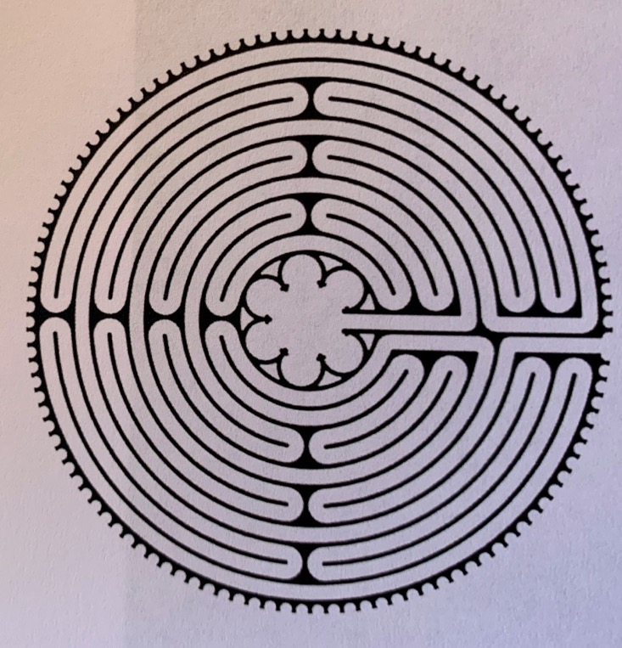
a labyrinth has one path it is designed to help you find your way

Slide 5
Medieval labyrinth

Slide 6
Classical labyrinth image 8110

Slide 7
Rambling rose

Slide 8
roman mosaic labyrinth image 8148

Slide 9
Labyrinths 2
experiences
Chartres akaroa
Mana
Te moata
Madonna rising
Banafsheh sayyad

Slide 10
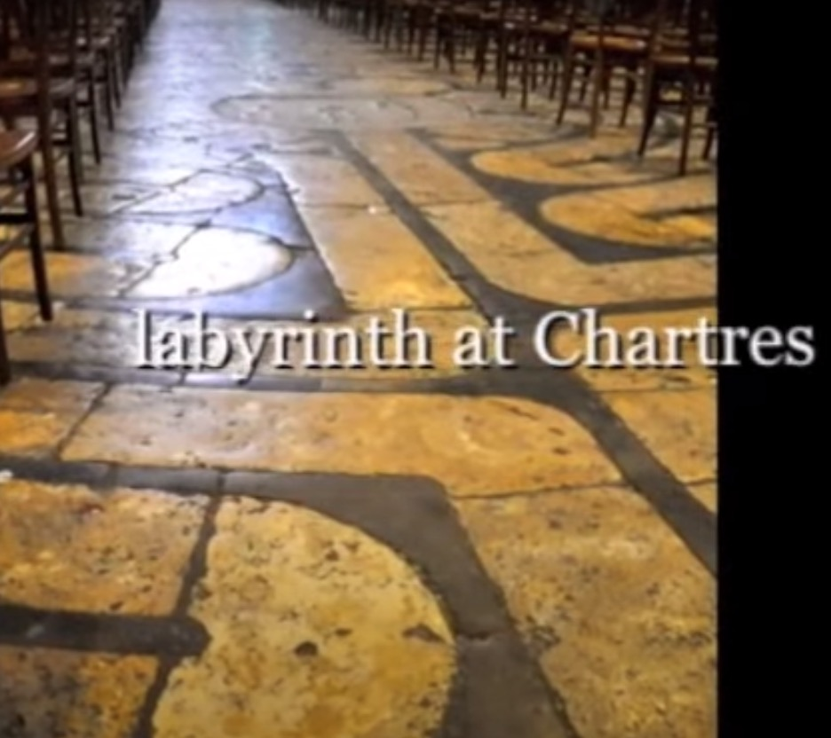
Chartres cathedral
https://youtu.be/QXfJNrrcgiI

Slide 11
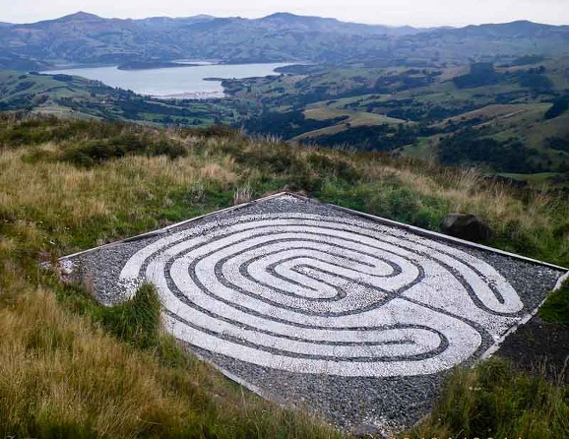
southern lights centre
akaroa

Slide 12
Mana retreat coromandel the sanctuary at mana
https://youtu.be/Wzd24t8QsKo

Slide 13
te moata retreat coromandel mystical rainforest labyrinth
https://youtu.be/1lFbJP9t8ko

Slide 14
Madonna rising chartres a spiritual pilgrimage
https://youtu.be/QXfJNrrcgiI

Slide 15
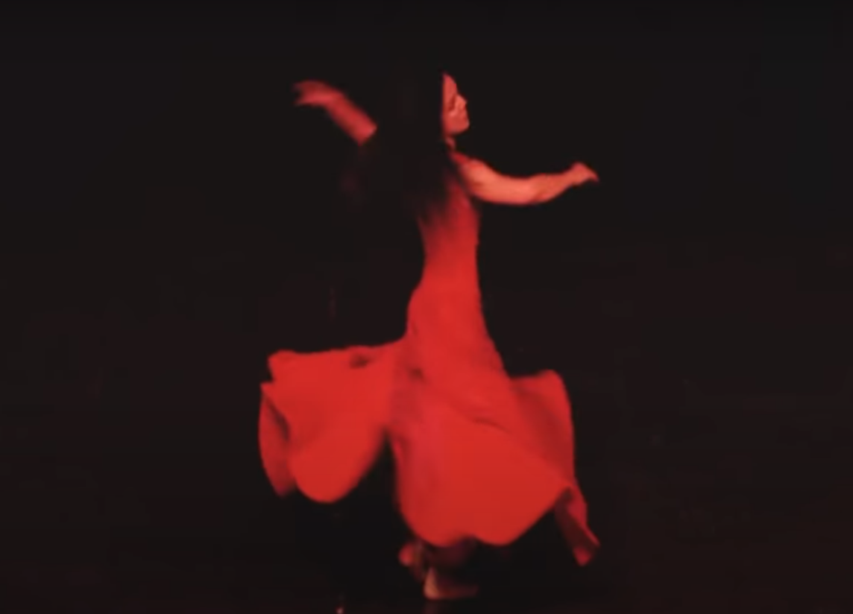
Banafsheh sayyad persian mystical dance
Add photos

Slide 16
Labyrinths 3 videos
Grace cathedral, san francisco
Leucadia beach, california

Slide 17
Grace cathedral san francisco
https://www.youtube.com/watch?v=WJ6J2Haktdc

Slide 18
Leucadia beach california
new years day
https://youtu.be/J5jegAFN9J4

Slide 19
labyrinths 4 photos
Grace Cathedral, San Francisco
New Mexico
South Africa
Czech Republic
Illinois
Norway
Canada
More on facebook - Labyrinth at The Light House

Slide 20
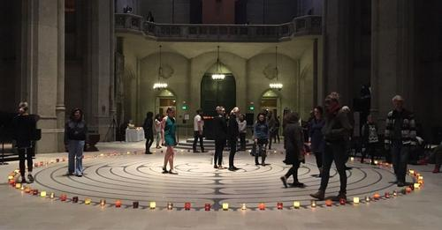
Grace Cathedral
San Francisco

Slide 21
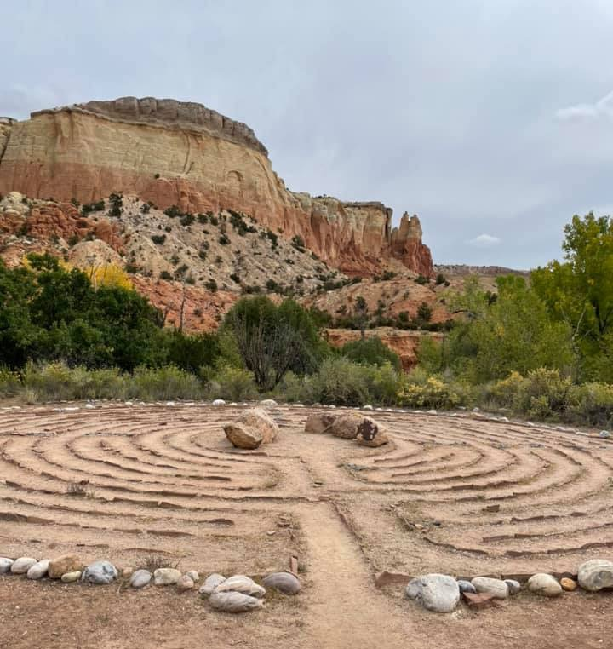
Landscape labyrinth New mexico

Slide 22
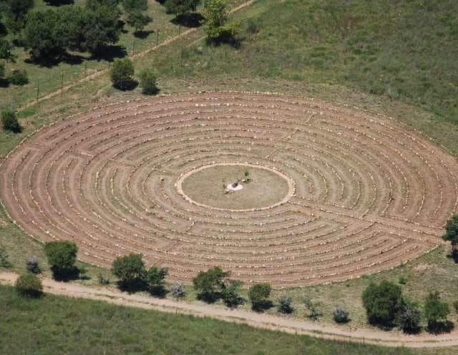
Crocodile river reserve south africa

Slide 23
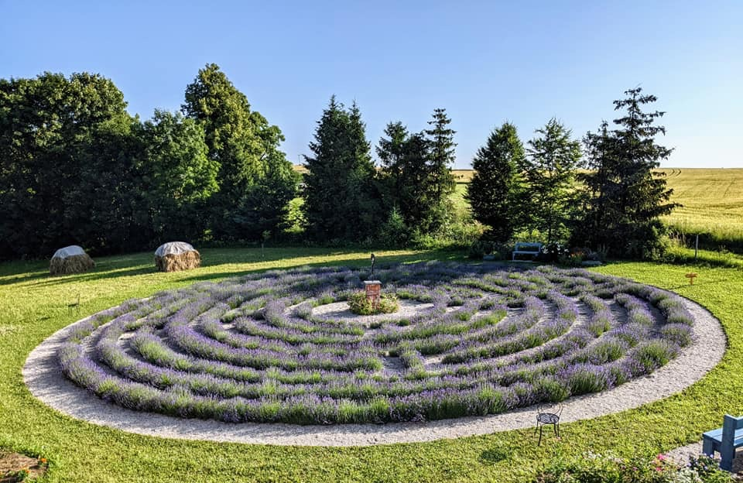
Lavender labyrinth czech republic

Slide 24
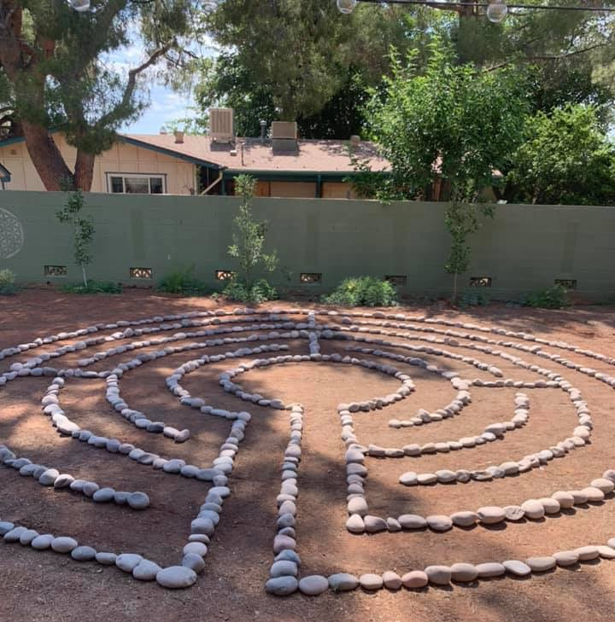
Backyard labyrinth sedona

Slide 25
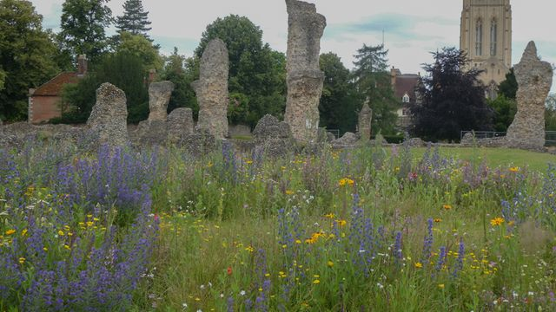
Bury st edmonds united kingdom

Slide 26
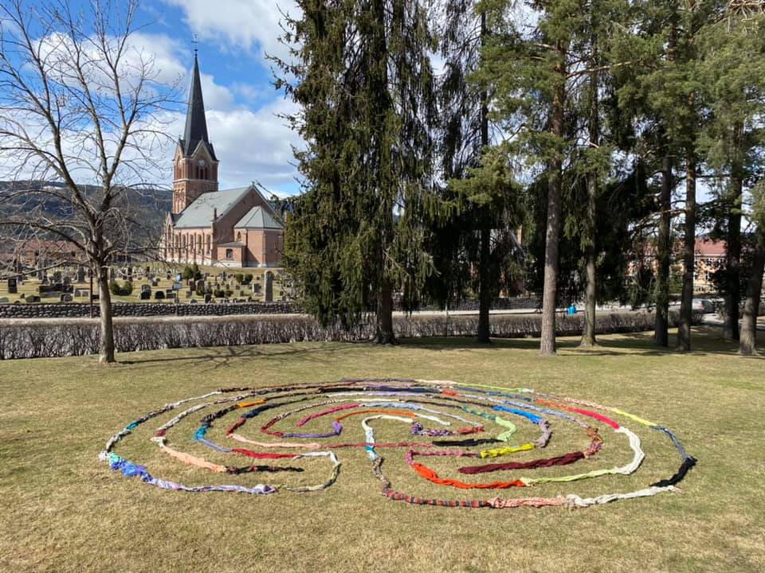
Temporary labyrinth norway

Slide 27
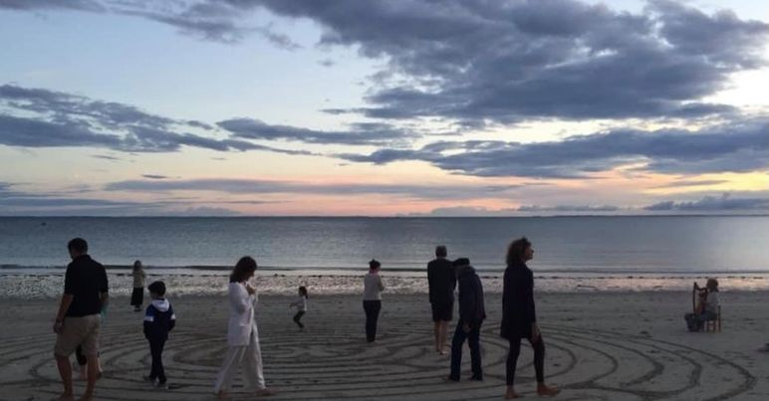
Full moon labyrinth Ontario

Slide 28
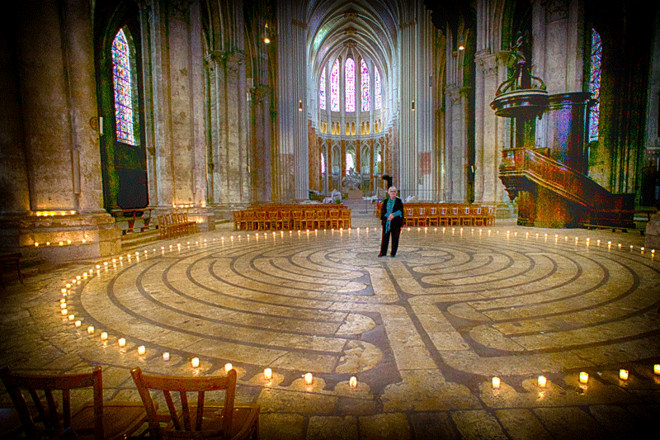
Ii walking a sacred path by lauren artress

Slide 29
walking a sacred path 2 handout To walk a sacred path new pilgrims. New paths walking – the process rediscovering the divine within

Slide 30
Walking a sacred path 2 stages of the labyrinth Releasing (letting go) Receiving (listening) Returning (reflecting, resolving, reclaiming)

Slide 31
walking a sacred path 3 guidelines follow your natural pace feel free to move around others you will meet others coming out turns are good place to pass let your gaze be soft let everything be a metaphor no photographs please

Slide 32
Walking a sacred path 4 expectations “this is your walk. We are walking together with others, but it is your walk” experience your experience – it may feel as if nothing has happened Each person’s experience is unique to them “I have no idea what’s going to happen for you” “can we give each other permission to be un-self conscious in the labyrinth?”

Slide 33
Iii Labyrinth at the light house
Design
Mandala in centre
Crystal grid
Current photos
Temple garden
Unity room, inner temple, temple
Footpath sign

Slide 34
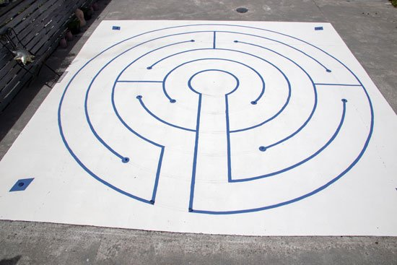

Slide 36
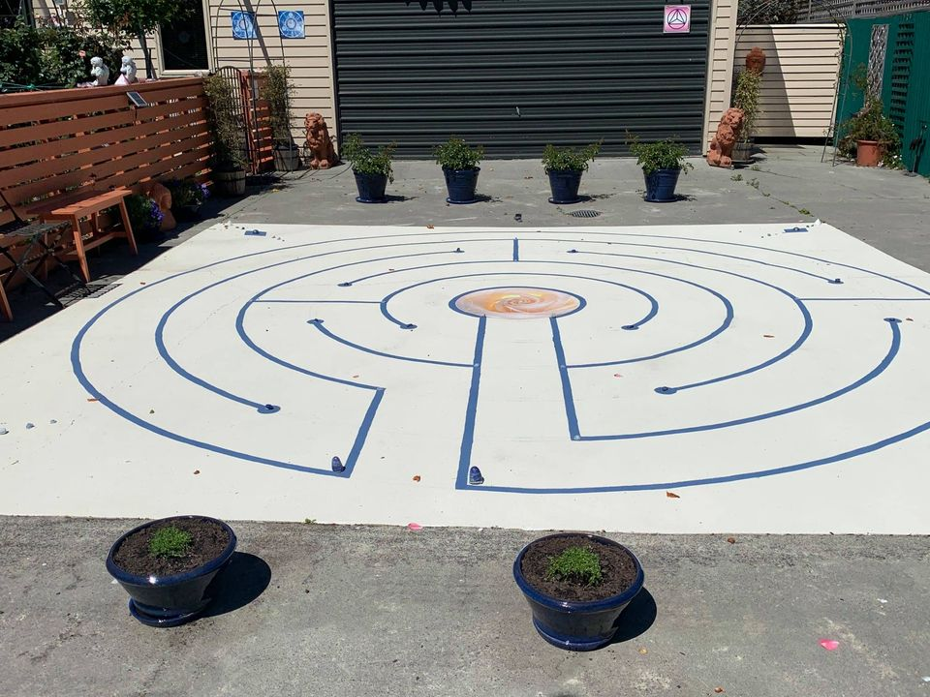

Slide 37
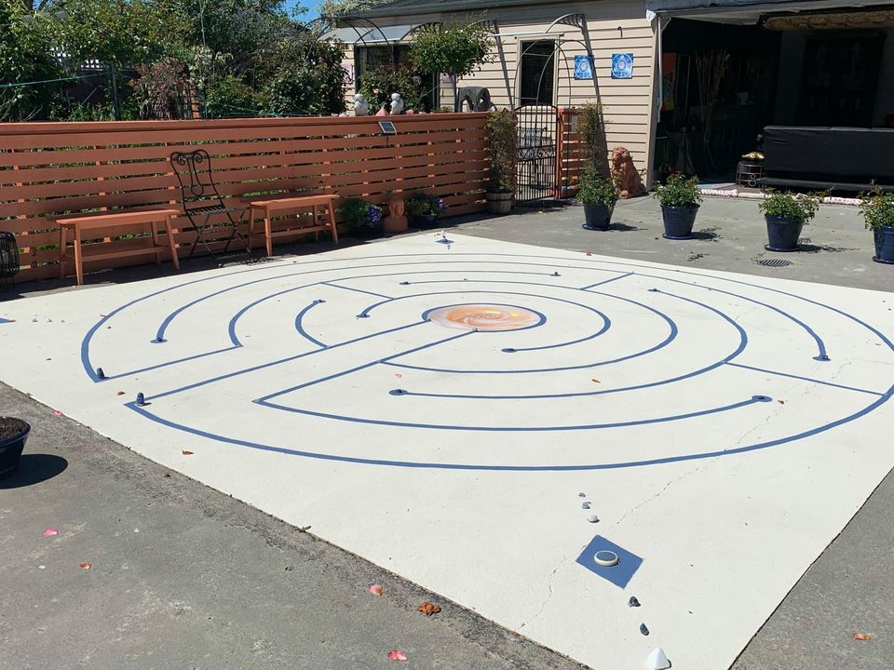

Slide 42
Add footpath sign

